Slide 1
Design of Ultrahigh Strength Stainless Steel Using Physical Metallurgy Guided ML & AI Model.
Presentation by: Rohan Joydhar & Vimal Kumar
B.Tech, 4th year, MME
Last edited: 6th june, 2022
Guided by: Dr. Ghanshyam Das

Slide 2

01 Introduction.
02 Dataset.
03 Model building.
04 Hardness prediction.
05 Alloy design.
06 Experimental validation.
07 Conclusion.
Table of content.

Slide 3
Introduction.

Slide 4
Using artificial intelligence & advancement in physical metallurgy an ultrahigh strength steel is designed and tested using Thermo-calcⓒ. For data Thermo-calcⓒ database is used for training, Python and R is used for building machine learning model, data analytics and import graph generation.
Support vector machine (SVM) algorithm is used for machine learning. Sklearn python library is used model building and training.
For testing and cross validation model was trained and tested on on random split and different split percentage.

Slide 5
Dataset.

Slide 6
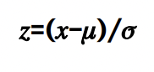
Thermo-calc TCFE9 dataset is used for this project.
Using Z² algorithm the dataset is normalised for better results.
There is about 500 vectors(data points) in the dataset.
Random distribution is used for separation of training & testing dataset.
Python & R is used for this job.

Slide 7
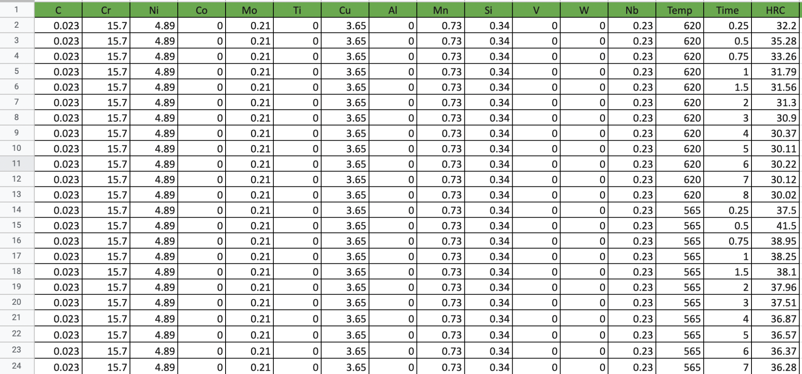
Sample of dataset:

Slide 8
Model building.

Slide 9
Support vector machine (SVM) algorithm is used for machine learning.
Sklearn python library is used model building and training.
RBF kernel is used to get maximum accuracy.
SVC classifier is used for prediction.
80% of dataset is used for training & 20% of dataset is used for training.
Random split is done for every epoch of training & testing.
Generated model shows 89% accuracy.

Slide 10
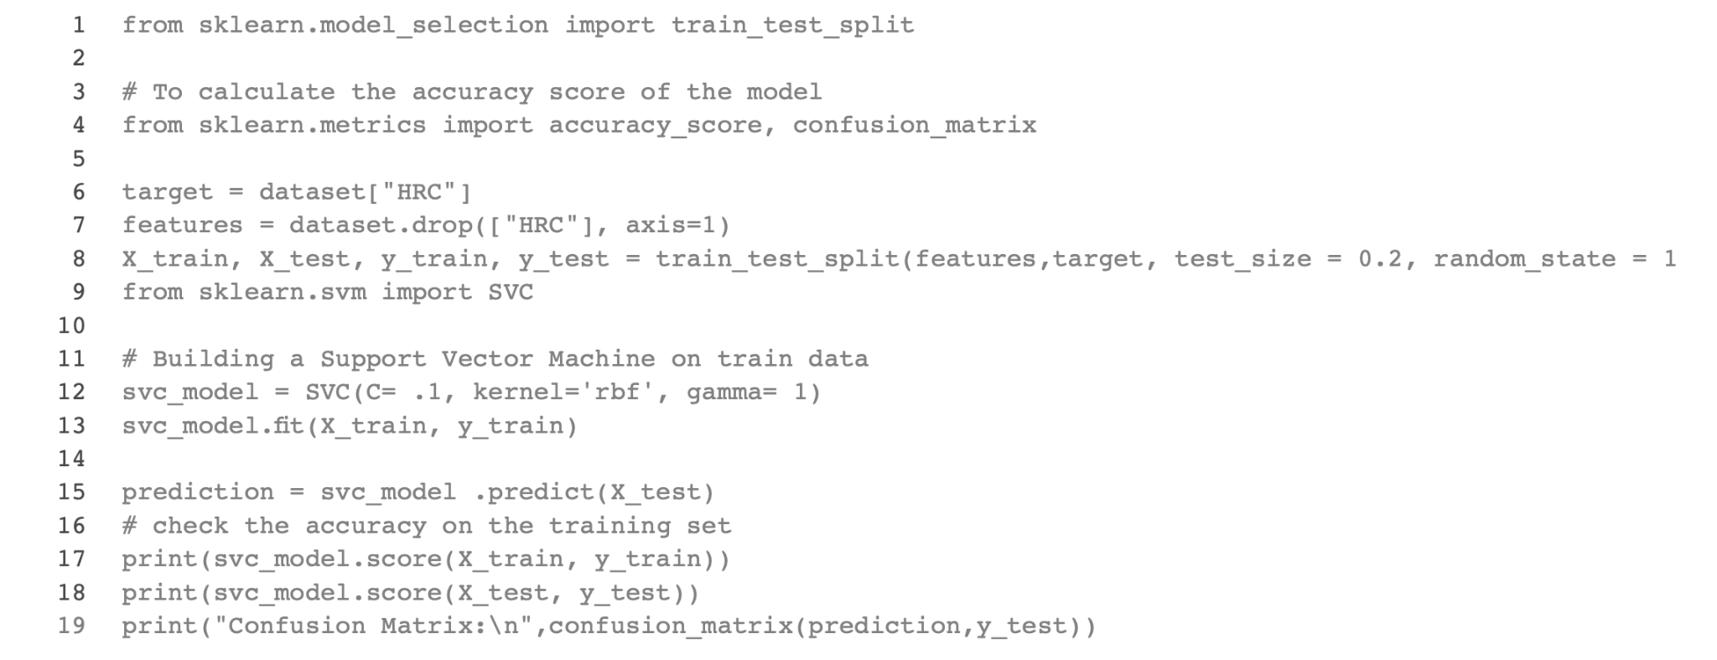

Slide 11
Hardness prediction.

Slide 12
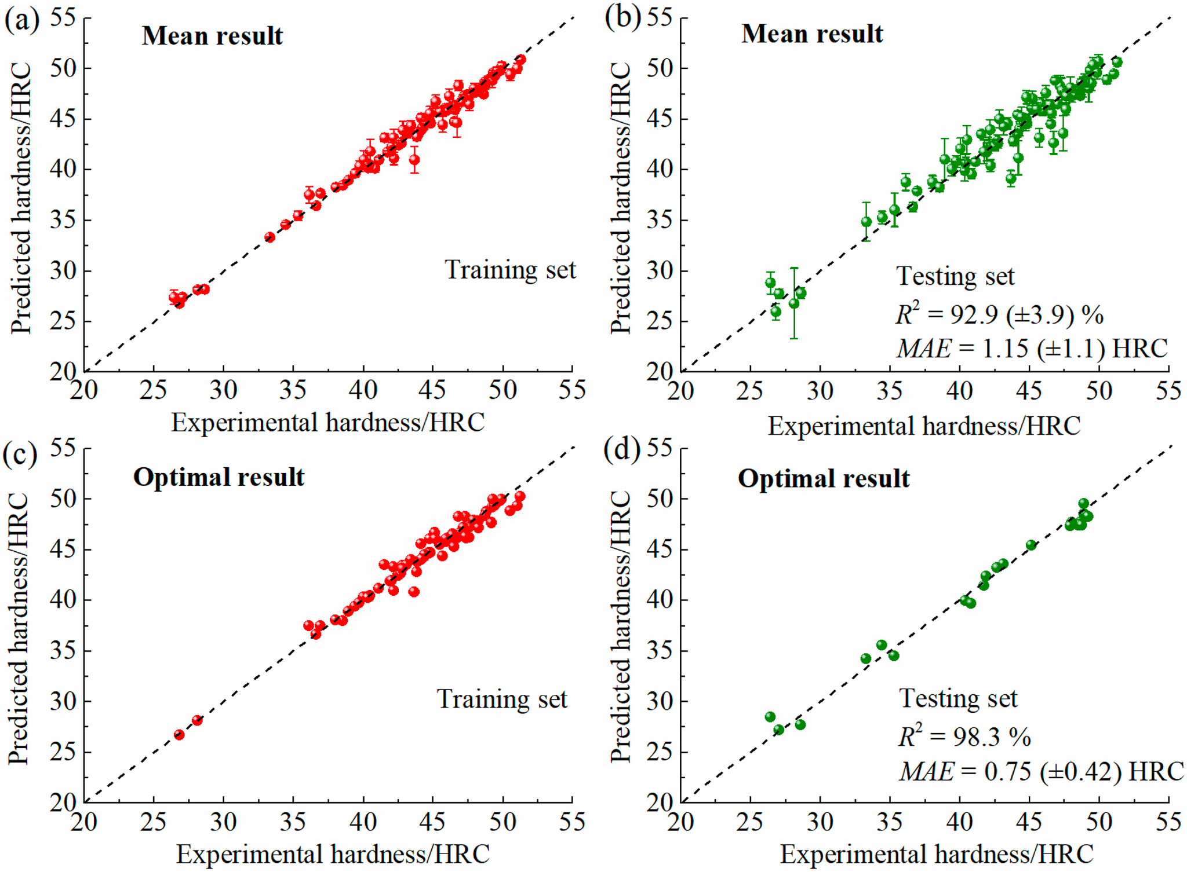
Predicted hardness.
MAE & R² generalisation is used for prediction to reduce the effect of multiple impression of same data.
Predicted hardness is in range of 26.4 to 51 of HRC.
RBF kernel reduces the clustering & overfitting.

Slide 13
Summary of Input & Output
 | Input/Output | Mini | Max | Mean | SD
Inputs | Carbon(wt.%) | 0.002 | 0.09 | 0.03 | 0.03
 | Nickel (wt.%) | 1.50 | 6.00 | 4.39 | 1.03
 | Cobalt (wt.%) | 1.04 | 2.01 | 1.41 | 0.47
 | Molybdenum (wt.%) | 2 | 5.30 | 4.37 | 0.91
 | Titanium (wt.%) | 0 | 0.20 | 0.12 | 0.10
 | Ageing temp (°C) | 300 | 600 | 498.77 | 60.27
 | Ageing time(hour) | 3.16 | 4.00 | 3.65 | 0.41
Output | Hardness (HRC) | 26.4 | 51.0 | 43.5 | 5.5

Slide 14
Alloy design.

Slide 15
GA(generic algo) is used for Alloy design.
GA allows us to effectively drop some layer for better prediction.
The output prediction of the SVM-PM model was used as an objective function of the GA.
GA established the relationship between the composition/process parameters and the hardness.
The optimization was performed over many generations until the output did not change for 10 consecutive iterations.

Slide 16
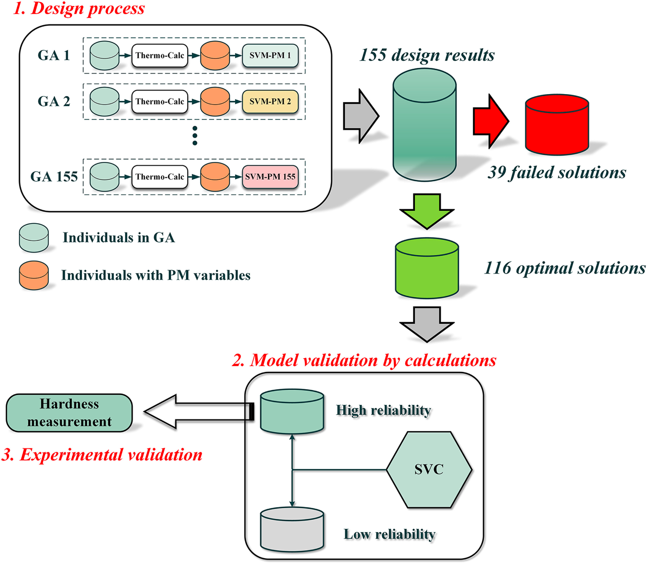
Design process.
To make the balance of high generalization ability and good diversity, a criterion of R² > 95%, i.e., 155 best models out of 500 possible models
116 optimal solution is found according to UHSS criteria.
In 116 solutions there are 2 alloy composition clustering.
This 2 alloys shows the optimal ageing conditions.

Slide 17
Output of alloy design.
 | Fe | C | Cr | Ni | Co | Mo | TAge | tage
Alloy 1 | Balance | 0.09 | 12.00 | 6.00 | 0.59 | 5.30 | 500 | 3.7
Alloy 2 | Balance | 0.09 | 13.25 | 7.50 | 0.01 | 2.1 | 560 | 4.0

Slide 18
Validation & testing.

Slide 19
2nd alloy composition is selected for testing.
Alloy 2 was smelted and cast into ingots of approximately 5 kg.
The ingot was forged at 1050 °C into a billet with a cross-section of 20 × 20 mm.
The square billet was machined into thin slabs with a thickness of 5 mm for heat treatment.
The alloy was heat treated by austenitization at 1050 °C for 1 h and then refrigerated in liquid nitrogen for 5 h.
The hardness of the quenched Alloy 2 was 34.4 HRC.
The hardness of the samples aged at 520 °C increased to 44.1 HRC, as a result of R-phase formation.
The peak hardness was obtained at 560 °C with a corresponding maximum value of 52.9 HRC.
The maximal hardness was obtained when the ageing time was 4 h at 560 °C

Slide 20
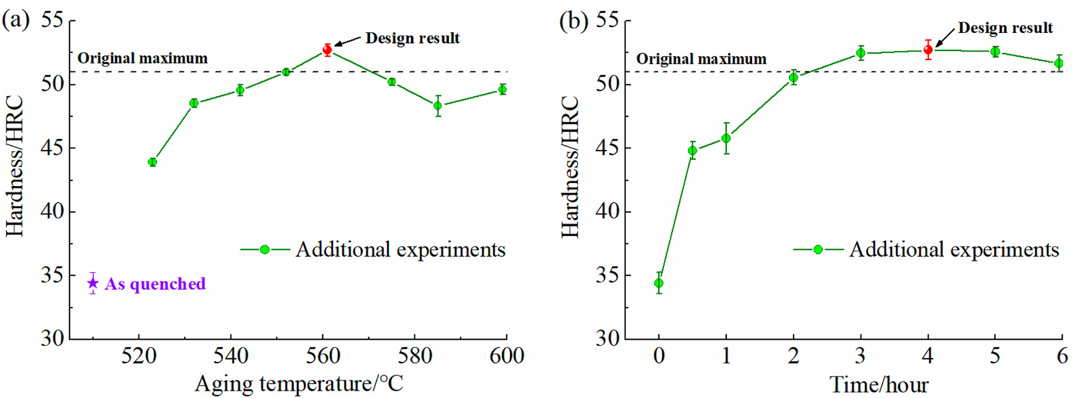
Experimental hardness of Alloy (a) variation of hardness with ageing temperature at an ageing time of 4 h; (b) variation of hardness with ageing time at an ageing temperature of 560 °C.

Slide 21
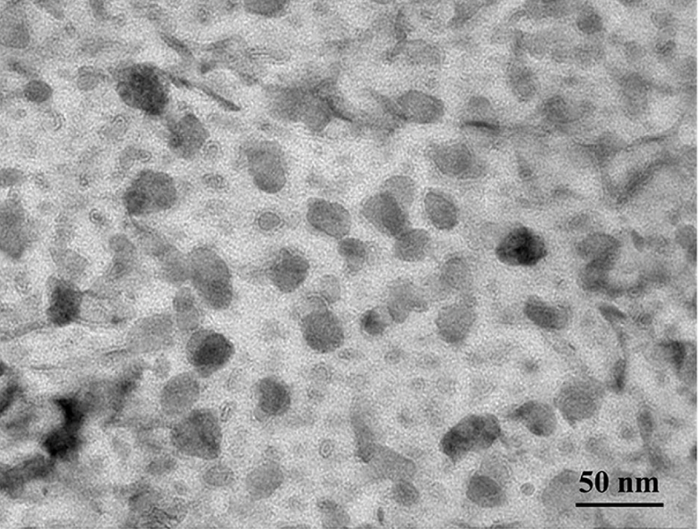
Tem image.
TEM image shows R-phase precipitates were homogeneously distributed in the lath martensite matrix & its structure was identified as hexagonal / rhombohedral.

Slide 22
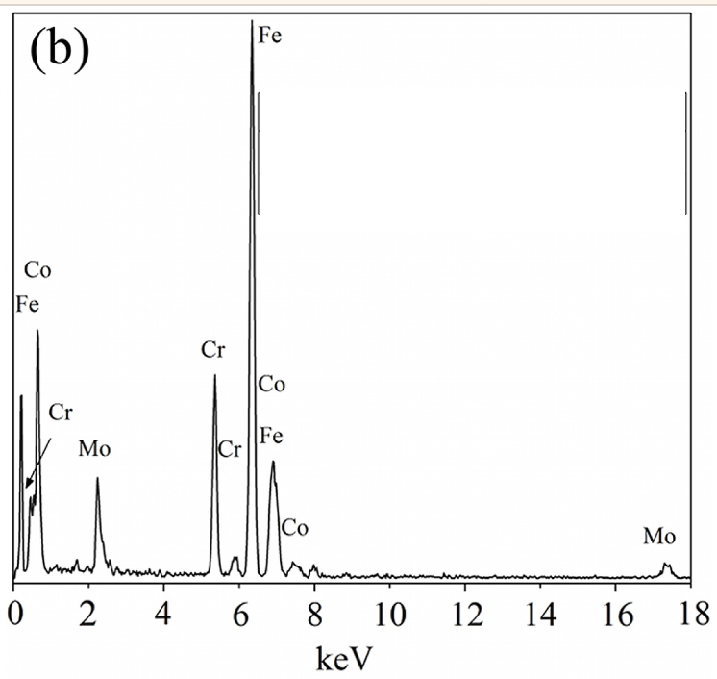
EDS.
EDS shows all alloying elements in samples.
7% M0, 13.85% Cr, 3.56% Ni, 1% Co, 5.8% Mo, 68.79% Fe.

Slide 23
Conclusion.

Slide 24
A material design process combining PM-guided ML regression, ML classifier and GA has been proposed in present work.
The hardness of the quenched Alloy 2 was 34.4 HRC and after ageing it’s increased upto 52.9 HRC.
Ageing increased the hardness of the alloy.
Due to presence of 13% Chromium the alloy is stainless.

